Slide 1
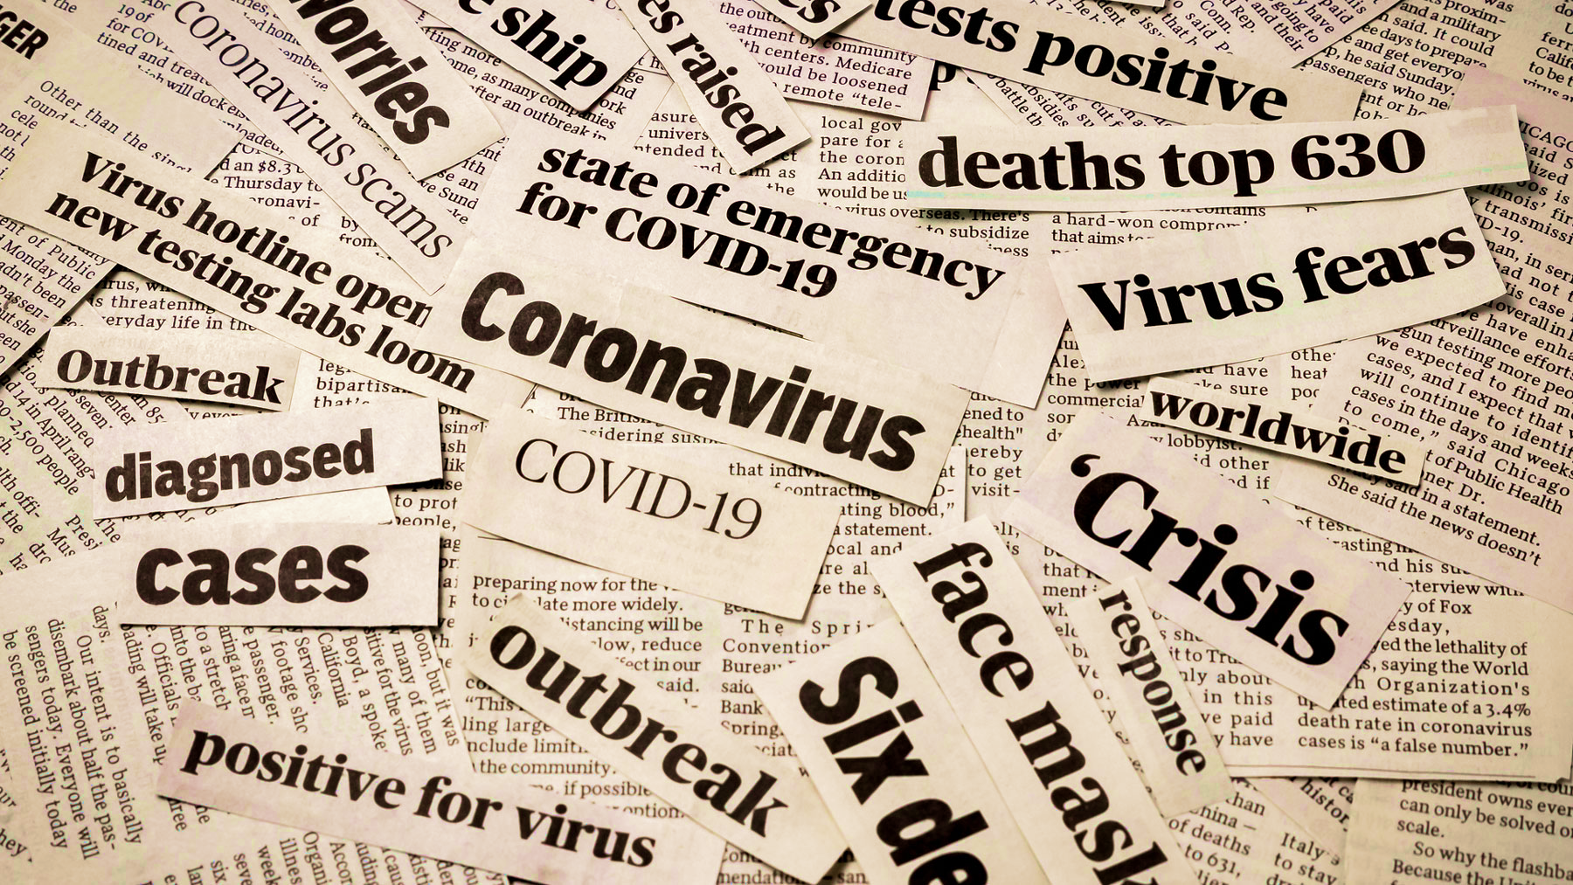
COVID-19
Rumor Analysis

